Slide 1
Week 6 Testing

Slide 2
“Testing shows the presence, not the absence of bugs.”
Edsger Dijkstra
“Bugs lurk in corners, and congregate at boundaries.”
Boris Beizer
“QA Engineer walks into a bar. Orders a beer. Orders 0 beers. Orders 999999999 beers. Orders a lizard. Orders -1 beers. Orders a sfdeljknesv.”
Bill Sempf
Software
Testing
Black/White
Box Testing
Equivalence Partitioning/ Boundary Analysis
Testing For Games

Slide 3

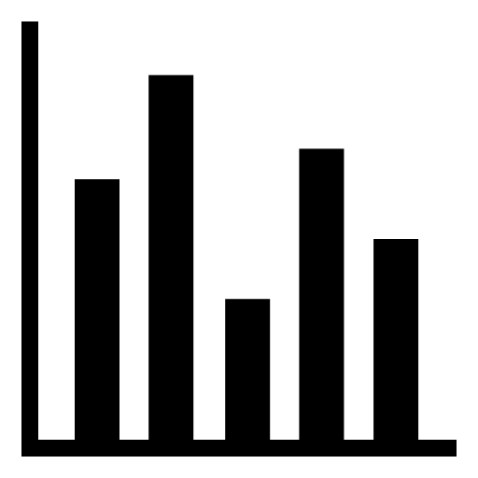

Outline
SOFTWARE tESTING
Black/white box testing
Equivalence partitioning/ boundary value analysis
Testing for games

Slide 4
Software Testing
Software
Testing
Black/White
Box Testing
Equivalence Partitioning/ Boundary Analysis
Testing For Games

Slide 5
Software Testing
The aim of testing is to evaluate and verify that a software product or application does what it is supposed to do. What do we mean by quality?
Functionality
Reliability
Performance
Anything that is specified in the requirements
Software Testing is important because if there are any bugs or errors in the software, it can be identified early and can be solved before delivery of the software product.
Properly tested software ensures reliability, security and high performance which further results in time saving, cost effectiveness and customer satisfaction.
Software
Testing
Black/White
Box Testing
Equivalence Partitioning/ Boundary Analysis
Testing For Games

Slide 6
Manual vs. Automation Testing
Manual Testing is a type of software testing in which test cases are executed manually by a tester without using any automated tools. The purpose of Manual Testing is to identify the bugs, issues, and defects in the software application. Manual testing is slow and tedious, but its strength is that it better handles complex scenarios. Manual Testing is necessary to check automation feasibility.
Automation Testing is performed by a machine that executes a test script that has been written in advance. The quality of your automated tests depends on how well your test scripts have been written. A huge benefit of automation testing is that there is no human intervention required and this allows test runs to be executed overnight. Using Automation can increase the effectiveness, test coverage, and execution speed in software testing.
Software
Testing
Black/White
Box Testing
Equivalence Partitioning/ Boundary Analysis
Testing For Games

Slide 7
Levels of Testing
Unit Testing
Integration Testing
Individual components of software are tested.
Unit Tests isolate a section of code and verify its correctness.
A unit may be an individual function, method, procedure, module, or object.
Unit tests help to fix bugs early in the development cycle and save costs.
Tools: JUnit/NUnit.
Software modules are integrated logically and tested as a group.
A typical software project consists of multiple software modules, coded by different programmers.
Typically carried out by Developers
System Testing
Acceptance Testing
Testing the complete and fully integrated software product.
Includes Functional/End-to-End testing to cover business requirements.
Performance Testing to check the behaviour of the system when under significant loads.
Exploratory Testing to ensure unique/edge case defects/errors are identified.
User Acceptance Testing is done in the final phase of testing after functional, integration and system testing is completed.
User Acceptance Testing is carried out in a separate testing environment with production-like data setup.
The aim is to determine whether the system is ready for delivery or deployment.
Typically carried out by a Test Team
Software
Testing
Black/White
Box Testing
Equivalence Partitioning/ Boundary Analysis
Testing For Games

Slide 8
Software Testing Life Cycle
The following diagram displays the six major phases in the Software Testing Life Cycle.
Requirement Analysis
Test
Planning
Test Case Development
Environment
Setup
Test
Execution
Test Cycle
Closure
Software
Testing
Black/White
Box Testing
Equivalence Partitioning/ Boundary Analysis
Testing For Games

Slide 9
Defects
A software defect is an error in coding which causes incorrect or unexpected results from a software program which does not meet actual requirements.
These defects or variations are referred by different names in different organizations like issues, errors, problems, bugs or incidents.
Any non-trivial piece of software is unlikely to be error free
Industry Average: about 15 – 50 errors per 1000 lines of delivered code.
It is possible to achieve zero defects but it is also costly. NASA was able to achieve zero defects for the Space Shuttle Software, but at a cost of thousands of dollars per line of code. If people will die because there are bugs in the software then that kind of cost makes sense. Most projects simply cannot afford the same level of testing as NASA.
Cost of errors: during development, errors are relatively cheap to fix. After deployment of software, errors can be very costly
Software
Testing
Black/White
Box Testing
Equivalence Partitioning/ Boundary Analysis
Testing For Games

Slide 10
Black/White box testing
Software
Testing
Black/White
Box Testing
Equivalence Partitioning/ Boundary Analysis
Testing For Games

Slide 11
Black Box Testing vs. White Box Testing
Testing can be further divided into Black Box and White Box Testing.
Black Box Testing
White Box Testing
Black-box testing is a testing approach which is used to test the software without knowing the internal structure of program or application.
It is mostly done by software testers.
Black Box testing has the main goal to test the behaviour of the software.
It also known as data-driven, box testing, and functional testing.
White-box testing is a testing technique in which internal structure is known to the tester/developer.
It is mostly done by software developers.
White Box testing has the main goal to test the internal operation or logic of the system.
It is also called structural testing, clear box testing, code-based testing, or glass box testing.
Software
Testing
Black/White
Box Testing
Equivalence Partitioning/ Boundary Analysis
Testing For Games

Slide 12
Equivalence Partitioning/ Boundary Analysis
Software
Testing
Black/White
Box Testing
Equivalence Partitioning/ Boundary Analysis
Testing For Games

Slide 13
Black Box – Equivalence Partitioning
How do we go about designing our test cases for a Black Box test plan?
Analyse the input domain – for each input, identify an Equivalence Class Partitioning
This divides up the range of possible values of an input into ranges of values which should be processed in the same way according to the specification
Partitions are identified as valid or invalid
Example:
Say a program asks for a person’s age in (integer) years and months.
What are the valid and invalid partitions of these two inputs?
Software
Testing
Black/White
Box Testing
Equivalence Partitioning/ Boundary Analysis
Testing For Games

Slide 14
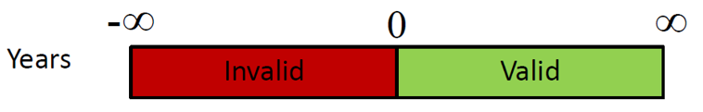
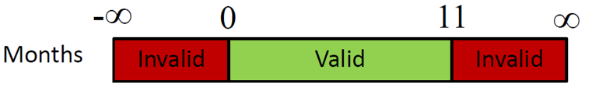
Equivalence Partitioning
In Words: Years < 0 (invalid) Years >= 0 (valid) Months < 0 (invalid) 0 <= Months <= 11 (valid) Months > 11 (invalid) | Tests are now designed so that each partition is covered by at least one test Only one invalid partition in a given test case (catching one error may cause another to go unnoticed).
Software
Testing
Black/White
Box Testing
Equivalence Partitioning/ Boundary Analysis
Testing For Games

Slide 15
Boundary Value Analysis
How to choose the values within the partitions?
A common approach is Boundary Value Analysis – choose test values on the boundaries of the partitions
Experience shows that errors are most common with boundary values, so it’s a good idea to choose these as representative of an equivalence class
What values would we choose for the month input in the previous example?
-1 | Invalid
0 | Valid
11 | Valid
12 | Invalid
Software
Testing
Black/White
Box Testing
Equivalence Partitioning/ Boundary Analysis
Testing For Games

Slide 16
Worked Example
Say we are writing a test plan for some code which calculates interest for a certain type of bank account.
Specification is:
Inputs
Deposit – a non-zero amount in pounds, up to the maximum deposit amount
Term – a time in whole years, at least one year and up to ten years
Outputs
Value – the value (in whole pounds), including compound interest, after the term . as elapsed. Interest rate depends on the initial amount, as follows.
Deposit Amount | Interest Rate
£1 - £1000 | 0.5%
£1001 - £10000 | 1.5%
£10001 - £50000 | 2.5%
Software
Testing
Black/White
Box Testing
Equivalence Partitioning/ Boundary Analysis
Testing For Games

Slide 17
Stage 1 – Equivalence Partitions
Write out the Equivalence Partitions for each of the inputs
Deposit – a non-zero amount in pounds, up to the maximum deposit amount
Term – a time in whole years, at least one year and up to ten years (inclusive)
Deposit Amount | Interest Rate
£1 - £1000 | 0.5%
£1001 - £10000 | 1.5%
£10001 - £50000 | 2.5%
Software
Testing
Black/White
Box Testing
Equivalence Partitioning/ Boundary Analysis
Testing For Games

Slide 18
Stage 1 – Equivalence Partitions - Continued
Input Domain
Equivalence Partitions
Deposit
Input | Valid Equivalence Classes | Invalid Equivalence Classes
Deposit | 1 – 1000 1001 – 10000 10001 - 50000 | <1 >50000
Term | 1 – 10 | <1 >10
Deposit Amount | Interest Rate
£1 - £1000 | 0.5%
£1001 - £10000 | 1.5%
£10001 - £50000 | 2.5%
Term
A time in whole years, at least one year and up to ten years (inclusive)
Software
Testing
Black/White
Box Testing
Equivalence Partitioning/ Boundary Analysis
Testing For Games

Slide 19
Stage 2 – Boundary Values
Now write out all the valid and invalid test values for each of the inputs
(using boundary values)
Input | Valid Values | Invalid Values
Deposit | 1, 1000, 1001, 10000, 10001, 50000 | 0, 50001
Term | 1, 10 | 0, 11
Software
Testing
Black/White
Box Testing
Equivalence Partitioning/ Boundary Analysis
Testing For Games

Slide 20
Stage 3 - Full Test Plan
Test# | Deposit | Term | Expected Result
1 | 1 | 1 | 1
2 | 1000 | 10 | 1051
3 | 1001 | 1 | 1016
4 | 10000 | 10 | 11605
5 | 10001 | 5 | 11315
6 | 50000 | 10 | 64004
7 | 0 | 1 | Error
8 | 50001 | 10 | Error
9 | 1000 | 0 | Error
10 | 1000 | 11 | Error
Write out the test cases – make sure that:
All your test values are covered
Cover the valid inputs first
At least one invalid input in a test case
Software
Testing
Black/White
Box Testing
Equivalence Partitioning/ Boundary Analysis
Testing For Games

Slide 21
Testing for games
Software
Testing
Black/White
Box Testing
Equivalence Partitioning/ Boundary Analysis
Testing For Games

Slide 22
Testing Games
Games are ‘messy’ – huge range and combination of inputs, timing important, scale (e.g. MMORPGs), but we can still use principles of Black Box testing
Two types of BB testing for games:
Compliance testing: checking by platform holders (e.g. Sony, Microsoft) that game meets functional standards. Standard test plans produced for this
Functional testing: checking the game plays are intended with reference to the requirements (design). Publisher/in-house/external QA team
Software
Testing
Black/White
Box Testing
Equivalence Partitioning/ Boundary Analysis
Testing For Games

Slide 23
Functional Testing for Games
We can still use the principles of equivalence partitioning and boundary value analysis in games testing: Look for the edge cases
e.g.
Buy 1001 bullets; Buy 0 bullets; Buy -1 bullets
Anything quantifiable should be tested, such as scores (e.g. Shoot zombie. Expected: zombie disappears, score increases by 100)
User interface/menus – test cases for functionality (e.g. sound/graphics options, load/save) Pause game, enter options, enter sound, set volume to zero, back, back, resume. Expected: All game sounds muted.
Software
Testing
Black/White
Box Testing
Equivalence Partitioning/ Boundary Analysis
Testing For Games

Slide 24
Functional Testing for Games
Functional testing: How to write test cases for a game?
Example: Splash screen
Test Case ID | Test Case Summary | Expected Result
01 | Start the game | Splash screen correctly displayed
Once in the splash screen – press space to start. All other inputs invalid. This gives us two more cases.
Test Case ID | Test Case Summary | Expected Result
02 | On splash screen – press keys other than space at random | No effect – splash screen still displayed correctly
03 | On splash screen – press space | Game starts as expected
Software
Testing
Black/White
Box Testing
Equivalence Partitioning/ Boundary Analysis
Testing For Games

Slide 25

Summary
Four stages of testing – unit, integration, system and acceptance
White Box and Black Box testing – refers to the level of knowledge of the code used in designing the tests
Equivalence Partitioning and Boundary Value Analysis – techniques for efficiently covering the inputs with tests which are likely to find errors

